Slide 1
Liquid Democracy in Ireland: Innovating democracy by directly empowering citizens. By Guillaume Van Aelst

Slide 2
1.
Introduction

Slide 3
Introduction
Rise populism
Dissatisfaction
Upgrade Democracy →Liquid Democracy!
Wisdom of Crowds
E-Voting → Blockchain (DAO)

Slide 4
To what extent can the blockchain be used to implement the concept of Liquid Democracy in Ireland, therefore disintermediating political parties and revolutionising the way citizens interact with politics?

Slide 5
2.
Methodology

Slide 6
Methodology
Research objectives
Liquid Democracy
Voting
Democracy
Referendums
Political parties
Wisdom of Crowds
Existing solutions
Propose solution
Evaluation objectives
Compare to current political system
Blockchain
Liquid Democracy in Ireland
Disintermediation Political parties

Slide 7
3.
Related Work
Voting, Referendum, Parties, Democracy and Existing Solutions

Slide 8
Voting
Old practice (17th century)
Limited Evolution
E-Voting: Pros & Cons
Binary option, polarising & restrictive

Slide 9
Referendum
Close to Direct Democracy, but…
Cumbersome and Costly
Complex subjects over-simplified: Colombia (& Brexit…)

Slide 10
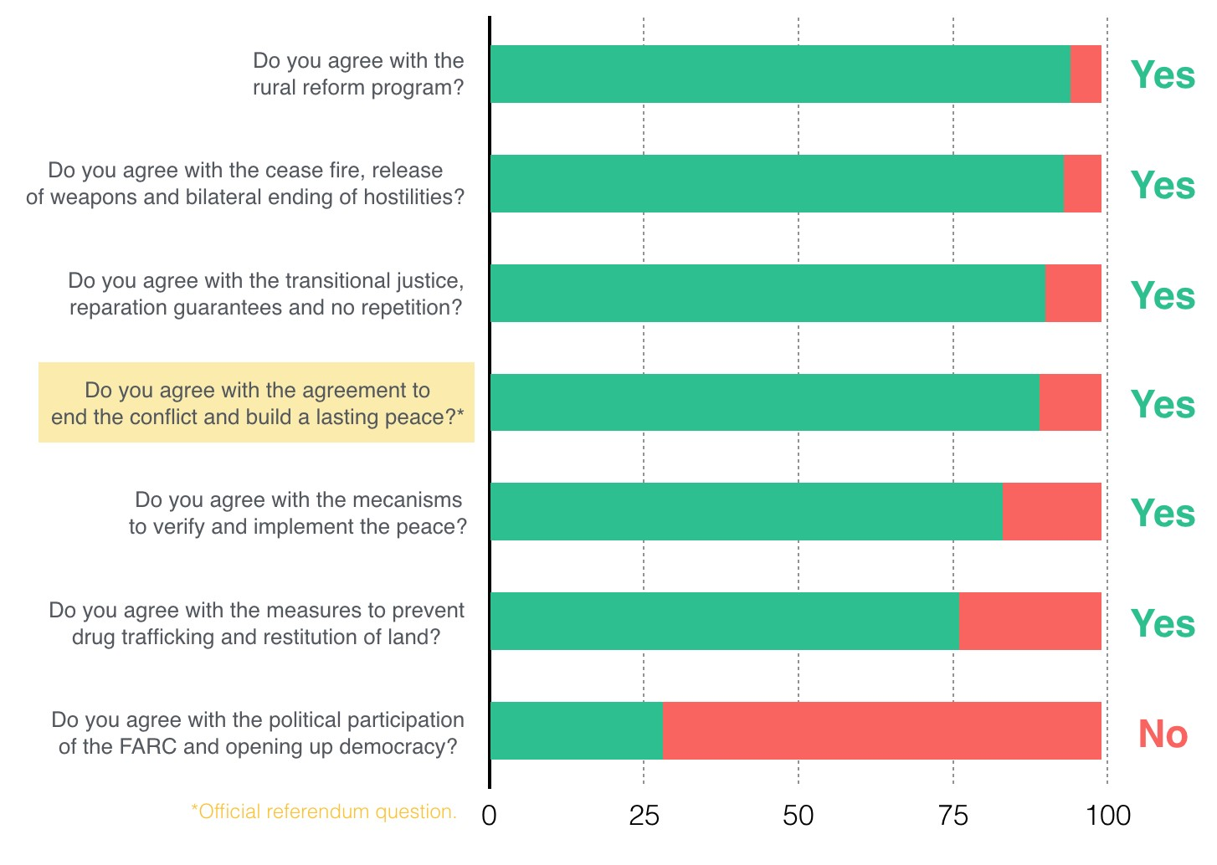

Slide 11
Political Parties
Dates as far back as 19th century
Partisanship as sports fans
Catch-all agendas – Party chooses voters
Emergence of new, radical parties (exploiting negative sentiment)

Slide 12
Democracy
Dates as far back as 5th century BCE
Direct democracy + Sortition
Societal factors (Population, logistic, complexity…)
Voting once every few years?
Liquid democracy (best both worlds)!
Vote issues
Transfer/Retract
Meritocracy & accountability

Slide 13
Existing Solutions
Flux, DemocracyEarth, DemocracyOS, D-Cent, MiVote, Followmyvote, Agora, Voatz, VoteWatcher, Coalichain, Liquid.us, or Opensourcepolitics…

Slide 14
4.
Implementation

Slide 15
Proposed Solution
Web Platform
Issues:
Voting (weight)
Proposing
Commenting (improve)
Curation (summarise, remove bias, include comments…)
Delegating (retracting = perform. feedback)

Slide 16
Why on Blockchain
Trustless (trust by computation)
Decentralised (corruption, censorship, SPF)
Transparent (verifiable and retraceable)
Pseudonymous (real identity hidden)
Immutable (in principle…)

Slide 17
5.
Evaluation

Slide 18
Improvements over current liberal democratic system
Enabling secure e-voting (track & remote vote)
Upgrading binarity of the votes (gauge importance)
More frequent, granular and cheaper polling
Harnessing the Wisdom of Crowds (New issues & broad audience)

Slide 19
New Issues / challenges / limitations
User friendly system (Balance security & BLOCKCHAIN)
Digital divide/exclusion (93%)
Vote Tracking
Black-Market
Bandwagon effect

Slide 20
To what extent can the blockchain be used to implement Liquid Democracy in Ireland, therefore disintermediating political parties and revolutionising the way citizens interact with politics?

Slide 21
Research Question
To what extent can the blockchain be used?
Implementing Liquid Democracy in Ireland
Disintermediation of political parties
Revolutionising the way citizens interact with politics

Slide 22
6.
Conclusion & Future Works

Slide 23
Conclusion & Future Works
Best Compromise
Solution proves possible!
“Government of the people, by the people, for the people” (Abraham Lincoln)
People readiness?

Slide 24
Bibliography
Antonopoulos, A. (2014). Bitcoin security model: trust by computation. http://radar.oreilly.com/2014/02/bitcoin-security-model-trust-bycomputation.html
Aristotle (1997). Politics, my emphasis Book III(11): 83–264.
Atzori, M. (2015). Blockchain technology and decentralized governance: Is the state still necessary?
Britannica, E. (2018a). Democracy. https://www.britannica.com/topic/democracy
Buterin, V. (2014). A next-generation smart contract and decentralized application platform - ethereum white paper.
Costello, R. (2017). The ideological space in Irish politics: comparing voters and parties, University of Limerick, Limerick, Ireland.
DemocracyEarth (2018). The social smart contract., Version 0.2: 11–28.
Kopstein, J., Lichbach, M. and Hanson, S. E. (2014). Comparative Politics: Interests, Identities, and Institutions in a Changing Global Order, Cambridge University Press, New York, USA.
McNally, S. (2017). 2. blockchain technologies week one and two fundamentals of bitcoin sean mcnally.
Olnes, S., Ubacht, J. and Janssen, M. (2017). Blockchain in government: Benefits and implications of distributed ledger technology for information sharing.
Zhang, B. and Zhou, H.-s. (2017). Brief announcement: Statement voting and liquid democracy, Proceedings of the ACM Symposium on Principles of Distributed Computing, ACM, pp. 359–361.

Slide 25
Thank you!
Next: Demo
Then: Questions?

